Slide 1
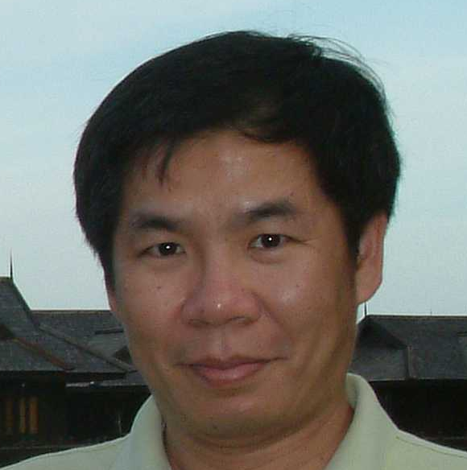
Sequence Alignment
Kun-Mao Chao (趙坤茂)
Department of Computer Science and Information Engineering
National Taiwan University, Taiwan
WWW: http://www.csie.ntu.edu.tw/~kmchao

Slide 2
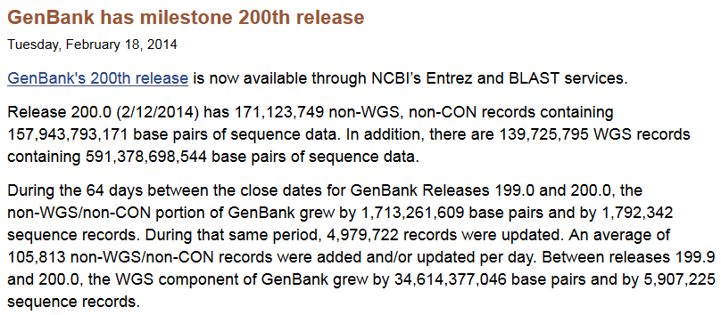
GenBank 200.0

Slide 3
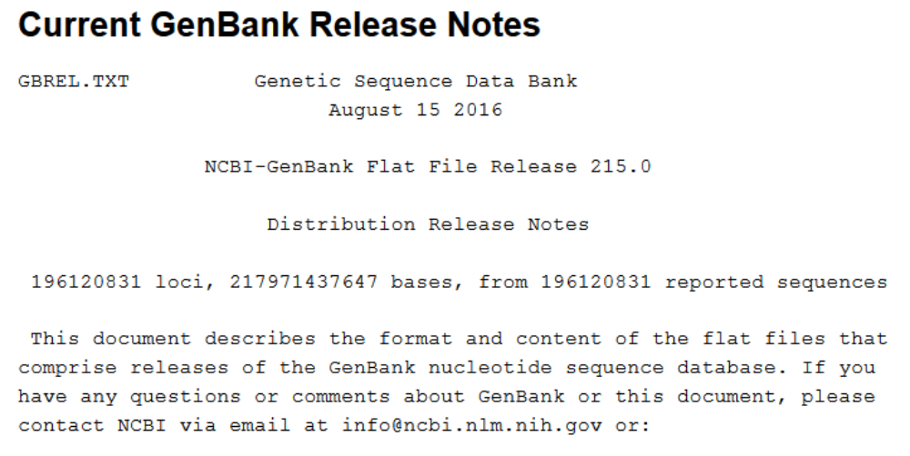
GenBank 215.0

Slide 4
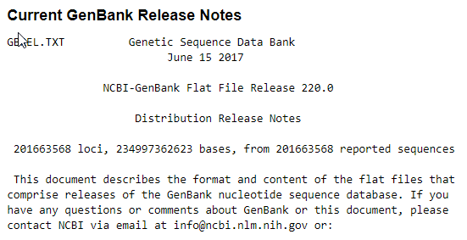
GenBank 220.0

Slide 5
Useful Websites
MIT Open Courseware
  e.g. Biology 7.012 Introduction to Biology
The International Society for Computational Biology:
  http://www.iscb.org/
National Center for Biotechnology Information (NCBI, NIH):
  http://www.ncbi.nlm.nih.gov/
European Bioinformatics Institute (EBI):
  http://www.ebi.ac.uk/
DNA Data Bank of Japan (DDBJ):
  http://www.ddbj.nig.ac.jp/index-e.html

Slide 6
orz’s sequence evolution
orz (kid)
OTZ (adult)
Orz (big head)
Crz (motorcycle driver)
on_ (soldier)
or2 (bottom up)
oΩ (back high)
STO (the other way around)
Oroz (me)
the origin?
their evolutionary relationships?
their putative functional relationships?

Slide 7
What?
THETR UTHIS MOREI
MPORT ANTTH ANTHE
FACTS
The truth is more important than the facts.

Slide 8
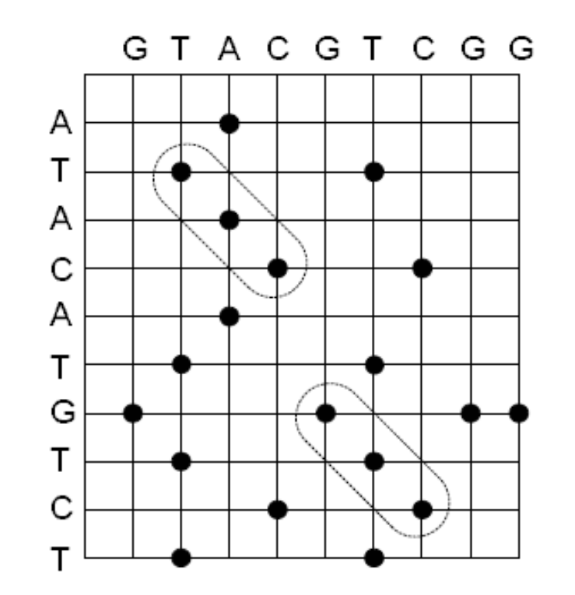
Dot Matrix

Slide 9
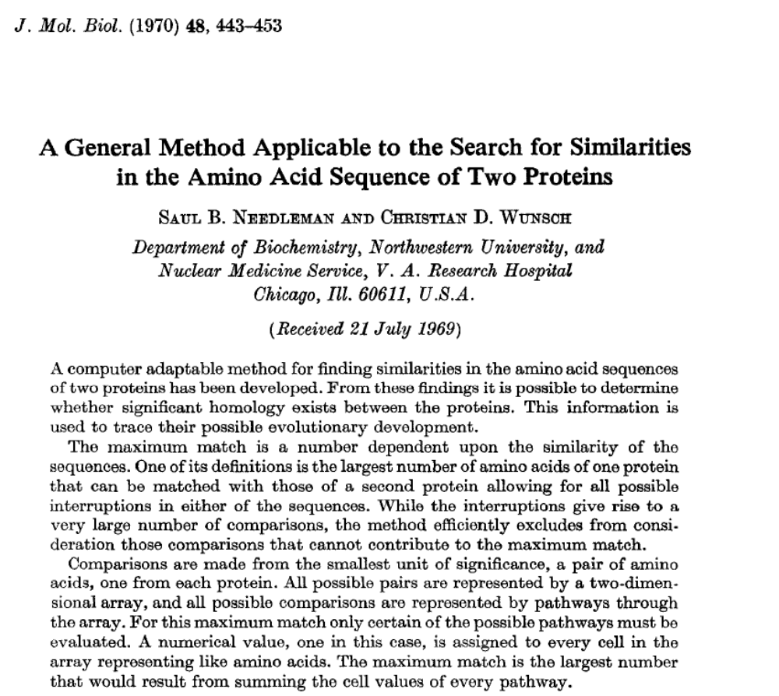

Slide 10
Pairwise Alignment
Sequence A: CTTAACT
Sequence B: CGGATCAT
An alignment of A and B:
C---TTAACT
CGGATCA--T
Sequence A
Sequence B

Slide 11
Pairwise Alignment
Sequence A: CTTAACT
Sequence B: CGGATCAT
An alignment of A and B:
Mismatch
Match
C---TTAACT
CGGATCA--T
Insertion gap
Deletion gap

Slide 12
Alignment Graph
Sequence A: CTTAACT
Sequence B: CGGATCAT
C G G A T C A T
C
T
T
A
A
C
T
C---TTAACT
CGGATCA--T

Slide 13
A simple scoring scheme
Match: +8 (w(x, y) = 8, if x = y)
Mismatch: -5 (w(x, y) = -5, if x ≠ y)
Each gap symbol: -3 (w(-,x)=w(x,-)=-3)
C - - - T T A A C T
C G G A T C A - - T
+8 -3 -3 -3 +8 -5 +8 -3 -3 +8 = +12
Alignment score

Slide 14
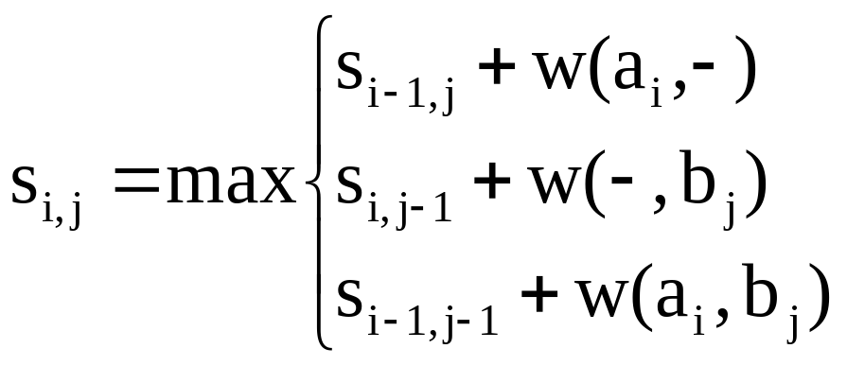
An optimal alignment
-- the alignment of maximum score
Let A=a₁a₂…a_{m} and B=b₁b₂…b_{n} .
S_{i,j}: the score of an optimal alignment between
a₁a₂…a_{i} and b₁b₂…b_{j}
With proper initializations, S_{i,j} can be computed
as follows.

Slide 15
Computing S_{i,j}
j
w(a_{i},b_{j})
w(a_{i},-)
i
w(-,b_{j})
S_{m,n}

Slide 16
Initializations
Match: 8
Mismatch: -5
Gap symbol: -3
C G G A T C A T
0 | -3 | -6 | -9 | -12 | -15 | -18 | -21 | -24
-3
-6
-9
-12
-15
-18
-21
C
T
T
A
A
C
T

Slide 17
S_{3,5} = ？
Match: 8
Mismatch: -5
Gap symbol: -3
C G G A T C A T
0 | -3 | -6 | -9 | -12 | -15 | -18 | -21 | -24
-3 | 8 | 5 | 2 | -1 | -4 | -7 | -10 | -13
-6 | 5 | 3 | 0 | -3 | 7 | 4 | 1 | -2
-9 | 2 | 0 | -2 | -5 | ?
-12
-15
-18
-21
C
T
T
A
A
C
T

Slide 18
S_{3,5} = 5
Match: 8
Mismatch: -5
Gap symbol: -3
C G G A T C A T
0 | -3 | -6 | -9 | -12 | -15 | -18 | -21 | -24
-3 | 8 | 5 | 2 | -1 | -4 | -7 | -10 | -13
-6 | 5 | 3 | 0 | -3 | 7 | 4 | 1 | -2
-9 | 2 | 0 | -2 | -5 | 5 | 2 | -1 | 9
-12 | -1 | -3 | -5 | 6 | 3 | 0 | 10 | 7
-15 | -4 | -6 | -8 | 3 | 1 | -2 | 8 | 5
-18 | -7 | -9 | -11 | 0 | -2 | 9 | 6 | 3
-21 | -10 | -12 | -14 | -3 | 8 | 6 | 4 | 14
C
T
T
A
A
C
T
optimal score

Slide 19
C T T A A C – T
C G G A T C A T
8 – 5 –5 +8 -5 +8 -3 +8 = 14
C G G A T C A T
0 | -3 | -6 | -9 | -12 | -15 | -18 | -21 | -24
-3 | 8 | 5 | 2 | -1 | -4 | -7 | -10 | -13
-6 | 5 | 3 | 0 | -3 | 7 | 4 | 1 | -2
-9 | 2 | 0 | -2 | -5 | 5 | 2 | -1 | 9
-12 | -1 | -3 | -5 | 6 | 3 | 0 | 10 | 7
-15 | -4 | -6 | -8 | 3 | 1 | -2 | 8 | 5
-18 | -7 | -9 | -11 | 0 | -2 | 9 | 6 | 3
-21 | -10 | -12 | -14 | -3 | 8 | 6 | 4 | 14
C
T
T
A
A
C
T

Slide 20
Now try this example in class
Sequence A: CAATTGA
Sequence B: GAATCTGC
Their optimal alignment？

Slide 21
Initializations
Match: 8
Mismatch: -5
Gap symbol: -3
G A A T C T G C
0 | -3 | -6 | -9 | -12 | -15 | -18 | -21 | -24
-3
-6
-9
-12
-15
-18
-21
C
AA
T
T
G
A

Slide 22
S_{4,2} = ？
Match: 8
Mismatch: -5
Gap symbol: -3
G A A T C T G C
0 | -3 | -6 | -9 | -12 | -15 | -18 | -21 | -24
-3 | -5 | -8 | -11 | -14 | -4 | -7 | -10 | -13
-6 | -8 | 3 | 0 | -3 | -6 | -9 | -12 | -15
-9 | -11 | 0 | 11 | 8 | 5 | 2 | -1 | -4
-12 | -14 | ?
-15
-18
-21
C
AA
T
T
G
A

Slide 23
S_{5,5} = ？
Match: 8
Mismatch: -5
Gap symbol: -3
G A A T C T G C
0 | -3 | -6 | -9 | -12 | -15 | -18 | -21 | -24
-3 | -5 | -8 | -11 | -14 | -4 | -7 | -10 | -13
-6 | -8 | 3 | 0 | -3 | -6 | -9 | -12 | -15
-9 | -11 | 0 | 11 | 8 | 5 | 2 | -1 | -4
-12 | -14 | -3 | 8 | 19 | 16 | 13 | 10 | 7
-15 | -17 | -6 | 5 | 16 | ?
-18
-21
C
AA
T
T
G
A

Slide 24
S_{5,5} = 14
Match: 8
Mismatch: -5
Gap symbol: -3
G A A T C T G C
0 | -3 | -6 | -9 | -12 | -15 | -18 | -21 | -24
-3 | -5 | -8 | -11 | -14 | -4 | -7 | -10 | -13
-6 | -8 | 3 | 0 | -3 | -6 | -9 | -12 | -15
-9 | -11 | 0 | 11 | 8 | 5 | 2 | -1 | -4
-12 | -14 | -3 | 8 | 19 | 16 | 13 | 10 | 7
-15 | -17 | -6 | 5 | 16 | 14 | 24 | 21 | 18
-18 | -7 | -9 | 2 | 13 | 11 | 21 | 32 | 29
-21 | -10 | 1 | -1 | 10 | 8 | 18 | 29 | 27
C
AA
T
T
G
A
optimal score

Slide 25
C A A T - T G A
G A A T C T G C
-5 +8 +8 +8 -3 +8 +8 -5 = 27
G A A T C T G C
0 | -3 | -6 | -9 | -12 | -15 | -18 | -21 | -24
-3 | -5 | -8 | -11 | -14 | -4 | -7 | -10 | -13
-6 | -8 | 3 | 0 | -3 | -6 | -9 | -12 | -15
-9 | -11 | 0 | 11 | 8 | 5 | 2 | -1 | -4
-12 | -14 | -3 | 8 | 19 | 16 | 13 | 10 | 7
-15 | -17 | -6 | 5 | 16 | 14 | 24 | 21 | 18
-18 | -7 | -9 | 2 | 13 | 11 | 21 | 32 | 29
-21 | -10 | 1 | -1 | 10 | 8 | 18 | 29 | 27
C
AA
T
T
G
A

Slide 26
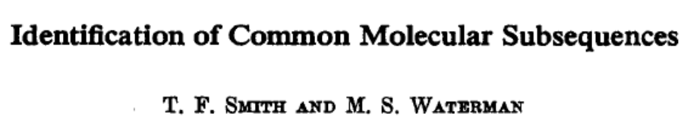

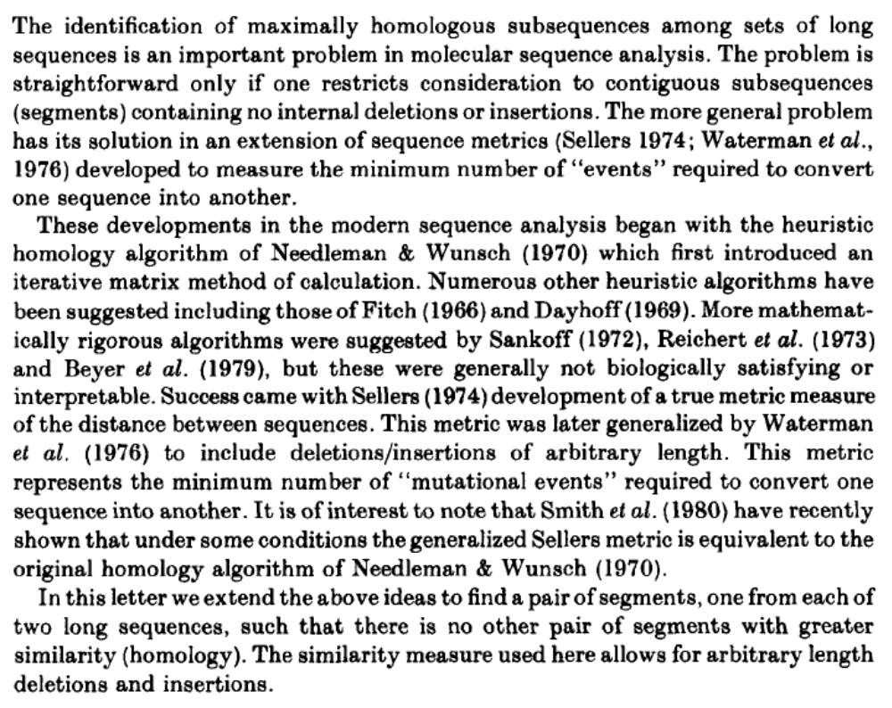

Slide 27
Global Alignment vs. Local Alignment
global alignment:
local alignment:

Slide 28
Maximum-sum interval
Given a sequence of real numbers a₁a₂…a_{n} , find a consecutive subsequence with the maximum sum.
9 –3 1 7 –15 2 3 –4 2 –7 6 –2 8 4 -9
For each position, we can compute the maximum-sum interval ending at that position in O(n) time. Therefore, a naive algorithm runs in O(n²) time.

Slide 29
Computing a segment sum in O(1) time?
Input: a sequence of real numbers a₁a₂…a_{n}
Query: the sum of a_{i} a_{i+1}…a_{j}

Slide 30
Computing a segment sum in O(1) time
prefix-sum(i) = a₁+a₂+…+a_{i}
  all n prefix sums are computable in O(n) time.
sum(i, j) = prefix-sum(j) – prefix-sum(i-1)
i
j
prefix-sum(j)
prefix-sum(i-1)

Slide 31
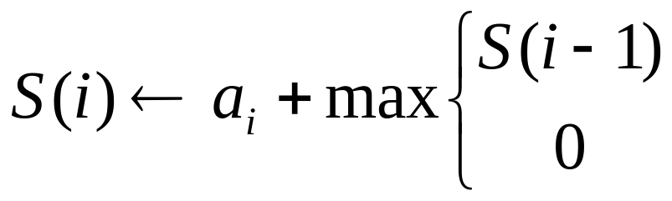
Maximum-sum interval
(The recurrence relation)
Define S(i) to be the maximum sum of the intervals ending at position i.
a_{i}
If S(i-1) < 0, concatenating a_{i} with its previous interval gives less sum than a_{i} itself.

Slide 32
Maximum-sum interval
(Tabular computation)
9 –3 1 7 –15 2 3 –4 2 –7 6 –2 8 4 -9
S(i) 9 6 7 14 –1 2 5 1 3 –4 6 4 12 16 7
The maximum sum

Slide 33
Maximum-sum interval
(Traceback)
9 –3 1 7 –15 2 3 –4 2 –7 6 –2 8 4 -9
S(i) 9 6 7 14 –1 2 5 1 3 –4 6 4 12 16 7
The maximum-sum interval: 6 -2 8 4

Slide 34
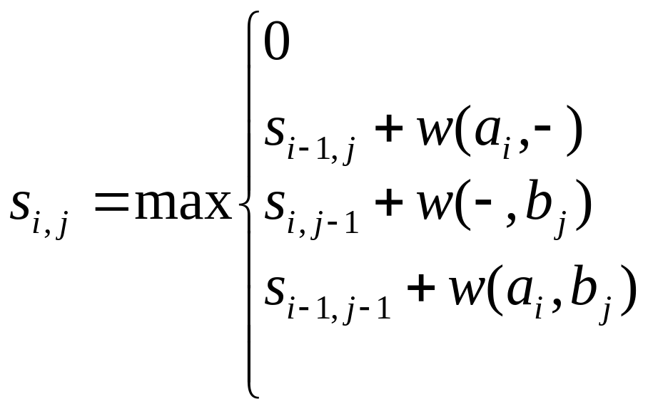
An optimal local alignment
S_{i,j}: the score of an optimal local alignment ending at (i, j) between a₁a₂…a_{i} and b₁b₂…b_{j}.
With proper initializations, S_{i,j} can be computed
as follows.

Slide 35
local alignment
Match: 8
Mismatch: -5
Gap symbol: -3
C G G A T C A T
0 | 0 | 0 | 0 | 0 | 0 | 0 | 0 | 0
0 | 8 | 5 | 2 | 0 | 0 | 8 | 5 | 2
0 | 5 | 3 | 0 | 0 | 8 | 5 | 3 | 13
0 | 2 | 0 | 0 | 0 | 8 | 5 | 2 | 11
0 | 0 | 0 | 0 | 8 | 5 | 3 | ?
0
0
0
C
T
T
A
A
C
T

Slide 36
local alignment
Match: 8
Mismatch: -5
Gap symbol: -3
C G G A T C A T
0 | 0 | 0 | 0 | 0 | 0 | 0 | 0 | 0
0 | 8 | 5 | 2 | 0 | 0 | 8 | 5 | 2
0 | 5 | 3 | 0 | 0 | 8 | 5 | 3 | 13
0 | 2 | 0 | 0 | 0 | 8 | 5 | 2 | 11
0 | 0 | 0 | 0 | 8 | 5 | 3 | 13 | 10
0 | 0 | 0 | 0 | 8 | 5 | 2 | 11 | 8
0 | 8 | 5 | 2 | 5 | 3 | 13 | 10 | 7
0 | 5 | 3 | 0 | 2 | 13 | 10 | 8 | 18
C
T
T
A
A
C
T
The best score

Slide 37
A – C - T
A T C A T
8-3+8-3+8 = 18
C G G A T C A T
0 | 0 | 0 | 0 | 0 | 0 | 0 | 0 | 0
0 | 8 | 5 | 2 | 0 | 0 | 8 | 5 | 2
0 | 5 | 3 | 0 | 0 | 8 | 5 | 3 | 13
0 | 2 | 0 | 0 | 0 | 8 | 5 | 2 | 11
0 | 0 | 0 | 0 | 8 | 5 | 3 | 13 | 10
0 | 0 | 0 | 0 | 8 | 5 | 2 | 11 | 8
0 | 8 | 5 | 2 | 5 | 3 | 13 | 10 | 7
0 | 5 | 3 | 0 | 2 | 13 | 10 | 8 | 18
C
T
T
A
A
C
T
The best score

Slide 38
Now try this example in class
Sequence A: CAATTGA
Sequence B: GAATCTGC
Their optimal local alignment？

Slide 39
Did you get it right?
G A A T C T G C
0 | 0 | 0 | 0 | 0 | 0 | 0 | 0 | 0
0 | 0 | 0 | 0 | 0 | 8 | 5 | 2 | 8
0 | 0 | 8 | 8 | 5 | 5 | 3 | 0 | 5
0 | 0 | 8 | 16 | 13 | 10 | 7 | 4 | 2
0 | 0 | 5 | 13 | 24 | 21 | 18 | 15 | 12
0 | 0 | 2 | 10 | 21 | 19 | 29 | 26 | 23
0 | 8 | 5 | 7 | 18 | 16 | 26 | 37 | 34
0 | 5 | 16 | 13 | 15 | 13 | 23 | 34 | 32
C
AA
T
T
G
A

Slide 40
A A T – T G
A A T C T G
8+8+8-3+8+8 = 37
G A A T C T G C
0 | 0 | 0 | 0 | 0 | 0 | 0 | 0 | 0
0 | 0 | 0 | 0 | 0 | 8 | 5 | 2 | 8
0 | 0 | 8 | 8 | 5 | 5 | 3 | 0 | 5
0 | 0 | 8 | 16 | 13 | 10 | 7 | 4 | 2
0 | 0 | 5 | 13 | 24 | 21 | 18 | 15 | 12
0 | 0 | 2 | 10 | 21 | 19 | 29 | 26 | 23
0 | 8 | 5 | 7 | 18 | 16 | 26 | 37 | 34
0 | 5 | 16 | 13 | 15 | 13 | 23 | 34 | 32
C
AA
T
T
G
A

Slide 41
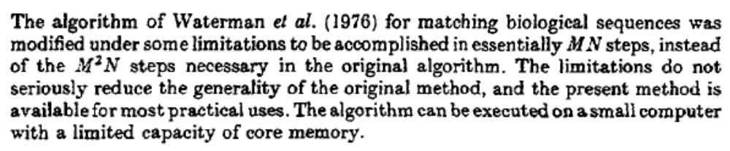
Osamu Gotoh

Slide 42
Affine gap penalties
Match: +8 (w(a, b) = 8, if a = b)
Mismatch: -5 (w(a, b) = -5, if a ≠ b)
Each gap symbol: -3 (w(-,b) = w(a,-) = -3)
Each gap is charged an extra gap-open penalty: -4.
-4
-4
C - - - T T A A C T
C G G A T C A - - T
+8 -3 -3 -3 +8 -5 +8 -3 -3 +8 = +12
Alignment score: 12 – 4 – 4 = 4

Slide 43
Affine gap panalties
A gap of length k is penalized x + k·y.
gap-open penalty
Three cases for alignment endings:
...x
...x
...x
...-
...-
...x
gap-symbol penalty
an aligned pair
This is the same as the scoring scheme
that penalizes the first symbol x + y
and an extended symbol y.
a deletion
an insertion

Slide 44
Affine gap penalties
Let D(i, j) denote the maximum score of any alignment between a₁a₂…a_{i} and b₁b₂…b_{j} ending with a deletion.
Let I(i, j) denote the maximum score of any alignment between a₁a₂…a_{i} and b₁b₂…b_{j} ending with an insertion.
Let S(i, j) denote the maximum score of any alignment between a₁a₂…a_{i} and b₁b₂…b_{j}.

Slide 45
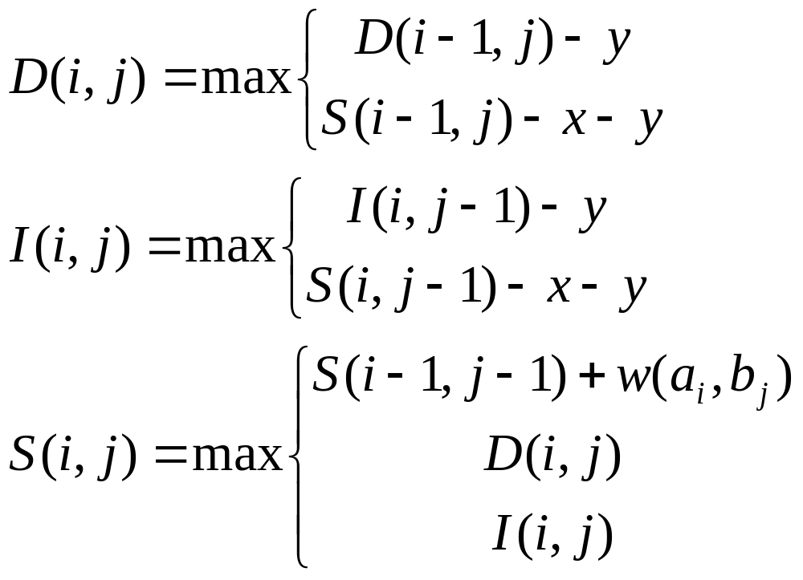
Affine gap penalties
(A gap of length k is penalized x + k·y.)

Slide 46
Affine gap penalties
D
D
I
S
I
S
w(a_{i},b_{j})
-y
-x-y
D
D
-x-y
I
S
I
S
-y

Slide 47
Constant gap penalties
Match: +8 (w(a, b) = 8, if a = b)
Mismatch: -5 (w(a, b) = -5, if a ≠ b)
Each gap symbol: 0 (w(-,b) = w(a,-) = 0)
Each gap is charged a constant penalty: -4.
-4
-4
C - - - T T A A C T
C G G A T C A - - T
+8 0 0 0 +8 -5 +8 0 0 +8 = +27
Alignment score: 27 – 4 – 4 = 19

Slide 48
Constant gap penalties
Let D(i, j) denote the maximum score of any alignment between a₁a₂…a_{i} and b₁b₂…b_{j} ending with a deletion.
Let I(i, j) denote the maximum score of any alignment between a₁a₂…a_{i} and b₁b₂…b_{j} ending with an insertion.
Let S(i, j) denote the maximum score of any alignment between a₁a₂…a_{i} and b₁b₂…b_{j}.

Slide 49
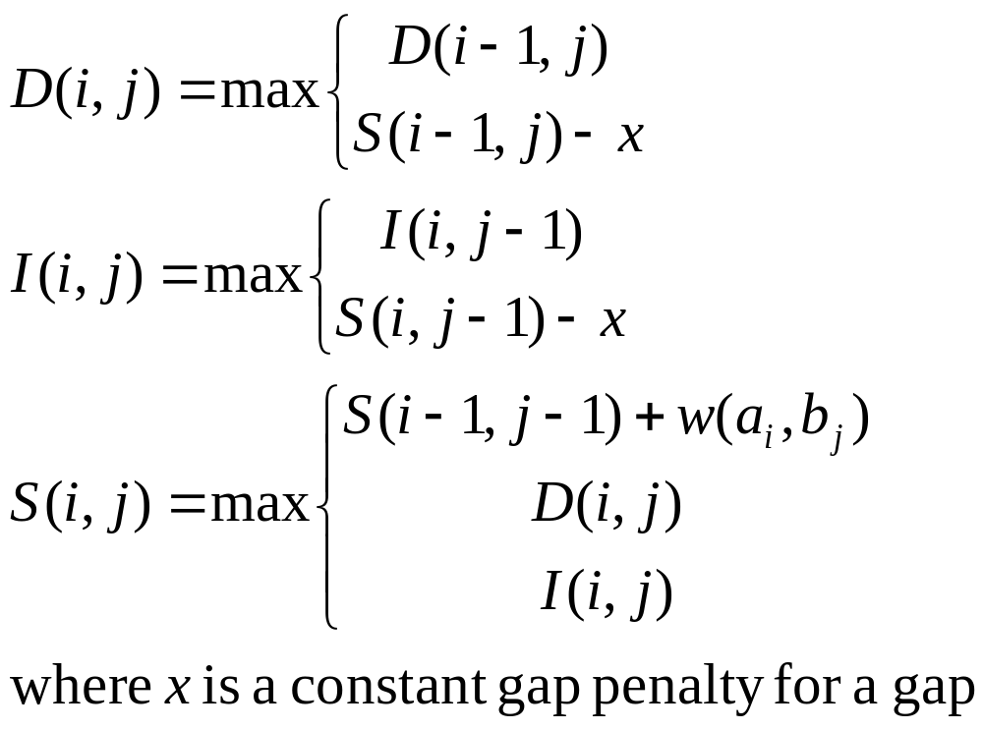
Constant gap penalties

Slide 50
Restricted affine gap panalties
A gap of length k is penalized x + f(k)·y.
where f(k) = k for k <= c and f(k) = c for k > c
Five cases for alignment endings:
...x
...x
...x
...-
...-
...x
and 5. for long gaps
an aligned pair
a deletion
an insertion

Slide 51
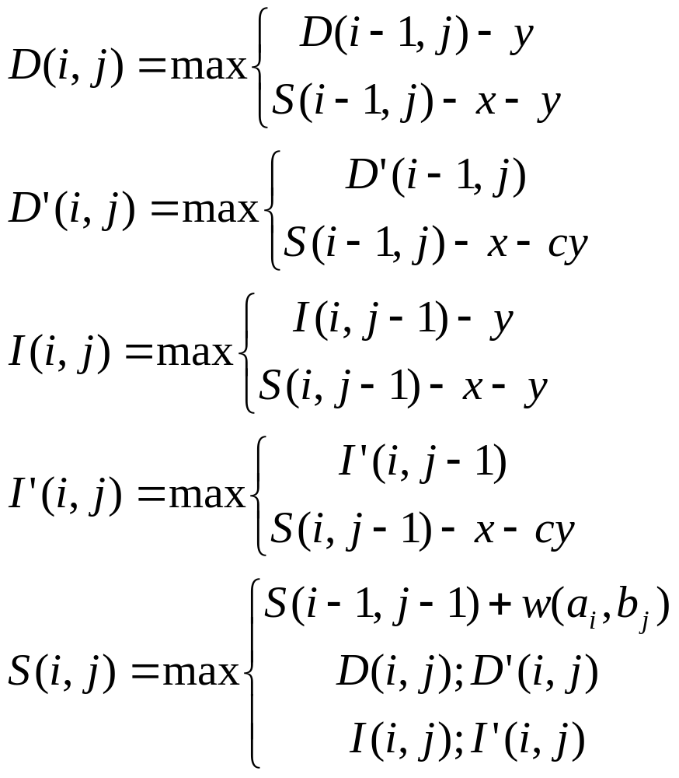
Restricted affine gap penalties

Slide 52
D(i, j) vs. D’(i, j)
Case 1: the best alignment ending at (i, j) with a deletion at the end has the last deletion gap of length <= c
D(i, j) >= D’(i, j)
Case 2: the best alignment ending at (i, j) with a deletion at the end has the last deletion gap of length >= c
D(i, j) <= D’(i, j)

Slide 53
Max{S(i,j)-x-ky, S(i,j)-x-cy}
S(i,j)-x-cy
c
k

